Slide 1
Module III Communication, Decision making, Stress and Conflict.

Slide 2
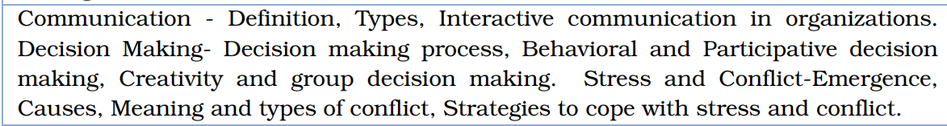
Syllabus

Slide 3
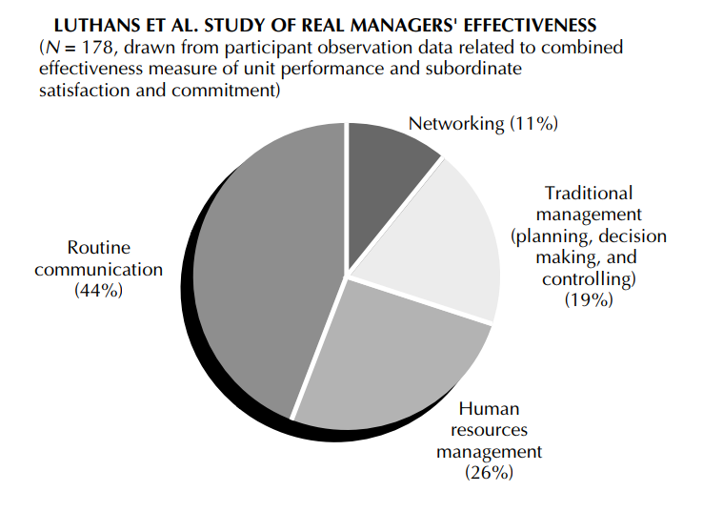
Effectiveness of Real Managers

Slide 4
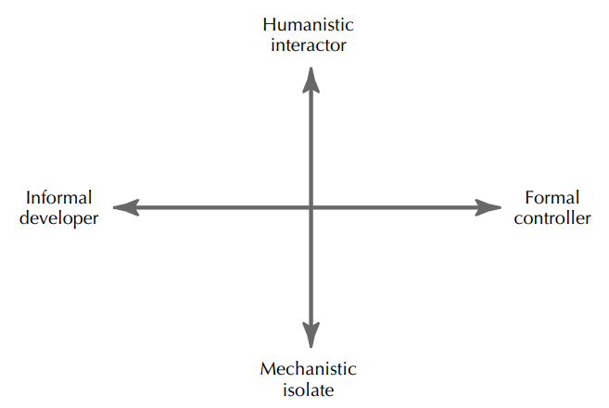
Managerial Communication Model
Humanistic Interactor: Frequently interacts both up and down the organization system and exhibits human-oriented activities
Mechanistic Isolate: Communicates very little, except on a formal basis
Informal developer: Communicates spontaneously in all directions and exhibits activities related to developing his or her people
Formal controller : Formally scheduled communication interaction and exhibits monitoring/controlling activities

Slide 5
Discussion Question
Do you think advanced information technology affecting interpersonal communication in organizations. Justify your answer
Suppose you are employed in an entry-level management position in a large bank. What specific considerations (contingencies) would you identify of sending an e-mail versus talking in person to someone else in the bank?

Slide 6
Advanced information technology significantly affects interpersonal communication—both positively and negatively.
Positive effects
Faster communication: Email, instant messaging, and collaboration tools enable real-time information sharing across levels and locations.
Improved accessibility: Managers and employees can communicate regardless of time and place (remote work, global teams).
Better documentation: Written digital communication provides records, accountability, and clarity.
Enhanced collaboration: Tools like video conferencing and shared platforms promote teamwork and coordination.
Negative effects
Reduced face-to-face interaction: Overreliance on digital tools can weaken personal relationships and trust.
Loss of non-verbal cues: Tone, emotions, and body language are often missing, leading to misunderstandings.
Information overload: Excessive emails and messages reduce attention and communication quality.
Impersonal communication: Technology may encourage mechanical, less empathetic interactions.

Slide 7
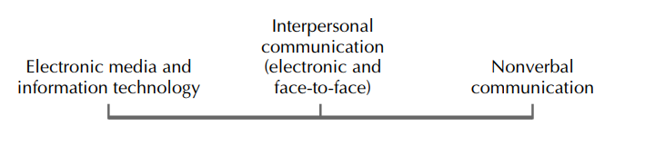
Continuum of Communication in Organizational Behavior

Slide 8
NonVerbal Communication
Nonword human responses (such as gestures, facial expressions)
Body Language: Body movements convey meanings and messages.
Facial expressions, handshakes, attire, physical appearance.
Paralanguage: Voice quality, tone, volume, speech rate, pitch, nonfluencies (saying “ah,” “um,” or “uh”), laughing, and yawning.

Slide 9
Improving Nonverbal Effectiveness
Look at what is happening in the situation
Consider the discrepancies between the nonverbal behavior and the verbal statements
Watch for subtleties in the nonverbal behavior

Slide 10
INTERPERSONAL COMMUNICATION
Middle ground between electronic media and information technology on the one extreme and nonverbal communication on the other
Focus on transferring information from one person to another
Knowing how to talk to others can be very useful.

Slide 11
Importance of How to Talk to Others
The Director: Person with short attention span, processes information very quickly, needs only the final result, forgets all the background information
The Free Spirit: Creative, considers alternative approaches before making a decision, not very good on follow-through
The Humanist: Manager likes everyone to be happy and is very concerned with the feelings of others; more patience needed to deal with
The Historian: thrives on details and background information, remains focused on the topic under consideration until it is reviewed and a decision is made

Slide 12
Importance of Feedback
Is there a noise in the forest if a tree crashes to the ground but no one is there to hear it???
Both sender and the receiver required for an interpersonal communication to take place
Proper follow-up and feedback is required so that the sender can check on how the message was actually interpreted
Feedback makes communication a two-way process

Slide 13
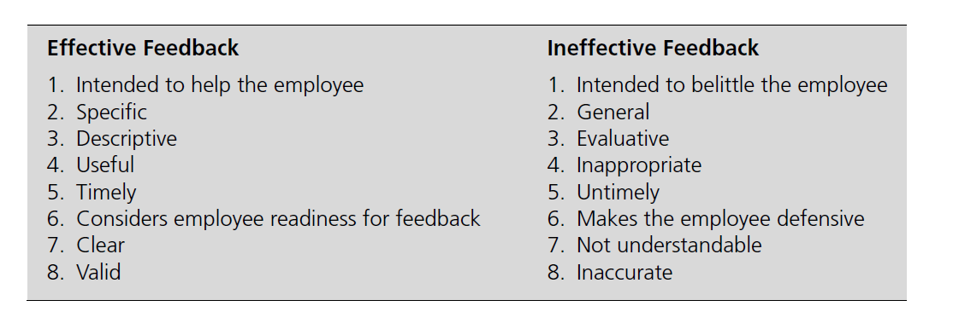
Characteristics of effective and ineffective feedback
Luthans and Martinko’s Characteristics of Feedback for Effective and Ineffective Interpersonal
Communication in Human Resource Management

Slide 14
Interactive communication
1. Task coordination: Department heads may meet monthly to discuss how each department is contributing to the system’s goals
2. Problem solving: Members of a department may assemble to discuss how they will handle a threatened budget cut
3. Information sharing: Members of one department may meet with the members of another department to give them some new data
4. Conflict resolution: Members of one department may meet to discuss a conflict inherent in the department or between departments

Slide 15
DECISION-MAKING PROCESS
Choosing between alternatives
Herbert A. Simon’s (decision theorist): 3 major phases in the decision-making process:
1. Intelligence activity - Searching the environment for conditions calling for decision making
2. Design activity - Inventing, developing, and analyzing possible courses of action take place
3. Choice activity - Actual choice: selecting a particular course of action from among those available

Slide 16
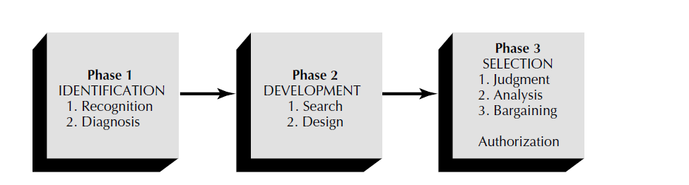
Mintzberg’s Empirically Based Phases of Decision Making in Organizations

Slide 17
Three phases of decision making: Mintzberg’s research
1. Identification phase - Recognition of a problem/opportunity arises and a diagnosis is made
2. Development phase - Search for existing standard procedures or solutions already in place or the design of a new, tailor-made solution
3. Selection phase - Choice of a solution is made
Three ways of making this selection
By the judgment of the decision maker on the basis of experience
By analysis of the alternatives on a logical, systematic basis
Bargaining when the selection involves a group of decision makers
Once the decision is formally accepted, an authorization is made.

Slide 18
Behavioral Decision Making
How people make decisions by considering their values, beliefs and preferences
People don’t always make “rational” decisions
Decision Rationality: If appropriate means are chosen to reach desired ends, the decision is said to be rational

Slide 19
Decision- Making Styles
Common decision-style topologies for managers:
(1) Charismatics (enthusiastic, captivating, talkative, dominant)
(2) Thinkers (cerebral, intelligent, logical, academic)
(3) Skeptics (demanding, disruptive, disagreeable, rebellious)
(4) Followers (responsible, cautious, brand-driven, bargain-conscious)
(5) Controllers (logical,unemotional, sensible, detail oriented, accurate, analytical)
Reflect how decision makers perceive what is happening around them and how they process information

Slide 20
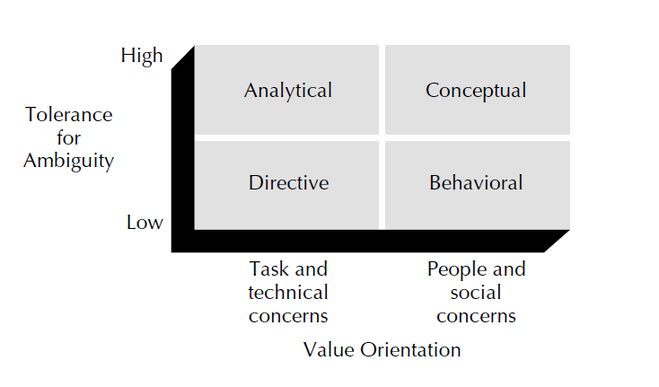
Decision- Making Styles
Simple 2 x 2 behavioral decision-making style matrix in 2 dimensions: value orientation and tolerance for ambiguity.
Value orientation: Decision maker’s concern for task and technical matters as opposed to people and social concerns.
Tolerance for ambiguity orientation: How much the decision maker needs structure and control

Slide 21
Decision- Making Styles
Directive Style decision makers:
→Low tolerance for ambiguity
→Oriented toward task and the technical concerns
→ Efficient, logical and systematic
→Focus on facts and get things done quickly, action oriented, display an autocratic leadership style.
Analytical Style decision makers:
High tolerance for ambiguity
Strong task and technical orientation.
Analyze situations
Takes long time to make decisions
Responds well to new or uncertain situations
Autocratic leadership style

Slide 22
Conceptual Style Decision makers:
High tolerance for ambiguity
Strong people and social concerns
Takes a broad perspective in solving problems and likes to consider many options and future possibilities
Gather a great deal of information by discussion with many people.
Willing to take risks and tend to be good at discovering creative solutions to problems
Idealistic and indecisive approach to decision making

Slide 23
Behavioral Style Decision makers
Low tolerance for ambiguity and strong people and social concerns
Opinions are openly exchanged
Receptive to suggestions
Avoid conflict
Overly concerned with keeping everyone happy
Difficult time saying no to people
Do not like making tough decisions, making someone upset
Note: Decision makers may have more than one dominant style.

Slide 24
Exercise
Although decisions are made in organizations every day, it is oftentimes either the large decisions, such as laying off many workers, or bad decisions, such as evidenced in the corporate scandals involving Enron, Arthur Andersen, or WorldCom, that receive all the attention. Using your search engine, come up with several organizations that have recently had a decision with negative or positive outcomes in the national news. Then, take these decisions, and consider the following:

Slide 25
Exercise
1. What were the reasons behind the poor decisions? Which framework did the poor decisions fall under (rational or social)? Were the poor decisions the result of using an incorrect decision-making model? Analyze the same issues for the good decisions that you found.
2. Could the decisions be improved by using one of the group decision-making techniques discussed in your text? Don’t forget to consider the downside to this, such as increased time to make the decision.
3. Did you find any specific organizations that had a pattern of wrong decisions? If so, discuss the possible reasons for this.

Slide 26
Stress and Conflict
What stress is and is not??
Stress is usually thought in negative terms.
Caused by something bad → distress
Positive, pleasant side caused by good things→ eustress.
Hindrance stressors → demands affecting negatively on personal growth and goal attainment.
Challenge stressors → high workload, time pressure, high responsibility etc:- → helps to learn and achieve (positive effect).

Slide 27
Activity – Handling Stress in Organization.
Analyse the following case studies and answer the following:
ABC marketing agency has a team of 10 employees who are responsible for managing multiple client accounts. The team has experiencing heavy workload due to this increase in client demand.
XYZ corporation is undergoing significant organizational changes like restructuring and layoffs. Employees are experiencing uncertainty in their jobs and future of the company.
MNZ healthcare has a team of nurses who are required to follow strict protocols and procedures and have a limited autonomy to make decisions.

Slide 28
Q.1. What are the potential sources of stress in each of the above scenario?
Q.2. How the given scenario affect the employee work-life balance , well being and productivity?
Q.3. What strategies the organization implement to address these scenario and support their employees?

Slide 29
Definitions of Stress:
Ivancevich and Matteson define stress simply as “the interaction of the individual with the environment”
Beehr and Newman define job stress as “a condition arising from the interaction of people and their jobs and characterized by changes within people that force them to deviate from their normal functioning.”
stress is defined as an adaptive response to an external situation that results in physical, psychological, and/or behavioral deviations for organizational participants.

Slide 30
Burnout:
What stress is not:
→ not simply anxiety
→not simply nervous tension
→not necessarily something damaging ,bad or to be avoided
→consequence of “losing a sense of the basic purpose and fulfillment of your work.”
→burnout is not a problem of the people themselves but of the social environment in which people work.
→closely associated with the so-called helping professions such as nursing, education, and social work.
→ examples???

Slide 31
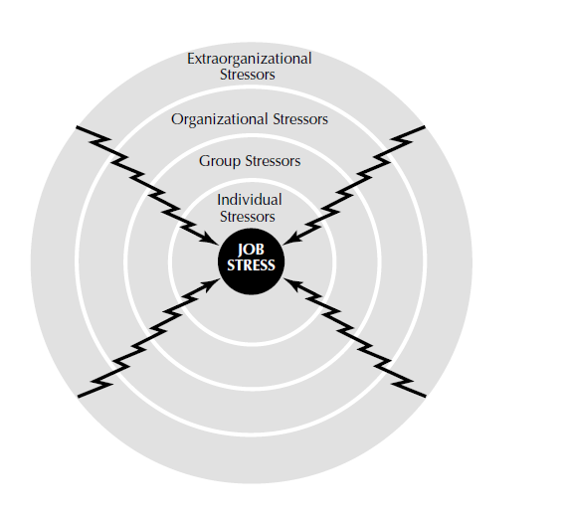
The Causes of Stress:
Categories of stressors affecting occupational stress:
Extra organizational stressors
Organizational stressors
Group stressors
Individual stressors

Slide 32
Extraorganizational Stressors
→the organization is greatly affected by the external environment; job stress is not limited to things inside the organization during working hours.
→Extraorganizational stressors include things such as societal/technological change, globalization, the family, relocation, economic and financial conditions, race and gender, and residential or community conditions.
person’s family has a big impact on one’s stress level; situations in family act as stressor for employees.
eg: crisis, illeness, relocation due to promotion.
Sociological-demographic variables such as race and gender can also become stressors.
→potential stress-related issues include differences in beliefs and values, differences in opportunities for rewards or promotions, and perceptions by minority employees.
→ Country culture and economic system also considered for analyzing extra org stressors.

Slide 33
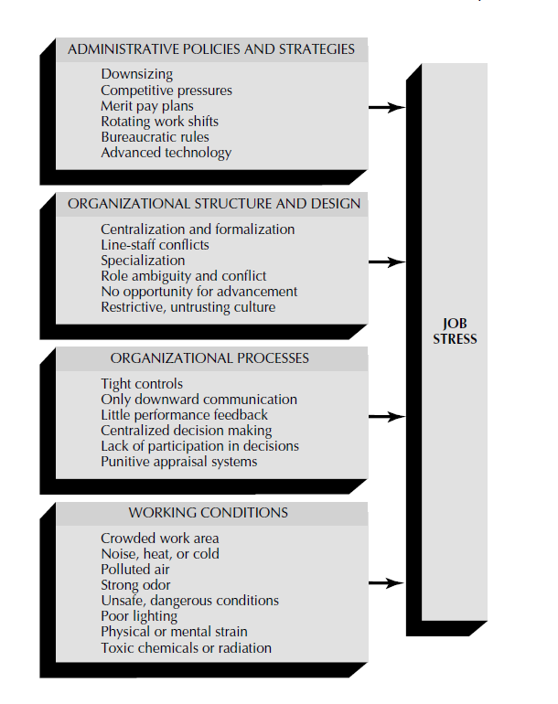
Organizational Stressors
Stress associated with the organization itself.
job stressors especially related to performance
includes role ambiguity, conflict and overload,
job insecurity, work-family conflict, environmental
uncertainty etc:
Fig: Macrolevel Organizational Stressors

Slide 34
Group Stressors
bullying is defined as “repeated, health-harming mistreatment that could involve verbal abuse, threatening, humiliating, or offensive behavior or actions; or work interference.
Obviously, bullying leads to tremendous stress for a victim and even those who witness this problem.
group stressors can be categorized into two areas:
→Lack of group cohesiveness: cohesiveness, or “togetherness,” is very important to employees, especially at the lower levels of organizations.
→ lack of cohesiveness leads to stress.
→Lack of social support: Employees are greatly affected by the support of one or more members of a cohesive group.
→ lack of social support is stressful.

Slide 35
Individual Stressors: The Role of Dispositions
the stressors discussed so far (extraorganizational, organizational, and group) all eventually get down to the individual level.
situational dimensions and individual dispositions affect stress outcomes.
individual dispositions such as Type A personality patterns, personal control, learned helplessness, and psychological hardiness all affect the level of stress someone experiences.
the intraindividual level of conflict from frustration, goals, and roles definitely has implications as individual stressors
Type A Characteristics and B Characteristics.
Type A employees (managers, salespersons, staff specialists, secretaries, or rank-and-file operating employees) experience considerable stress.
They are the ones who:
1. Work long, hard hours under constant deadline pressures and conditions for overload.
2. Often take work home at night or on weekends and are unable to relax.
3. Constantly compete with themselves, setting high standards of productivity that they
seem driven to maintain.

Slide 36
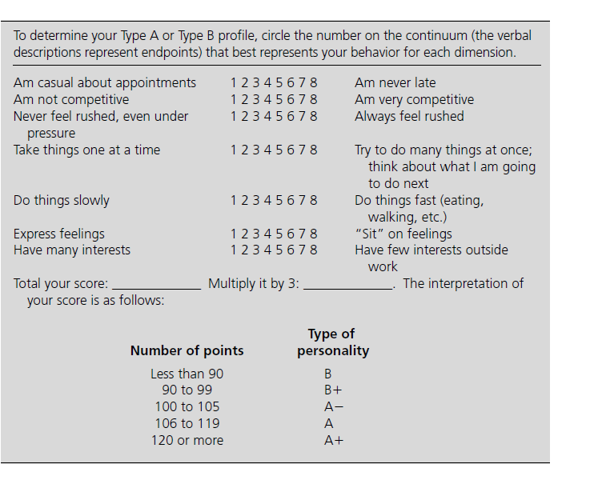
Class Activity . Determine your Personality type and analyze the pros and cons in each profile type.

Slide 37
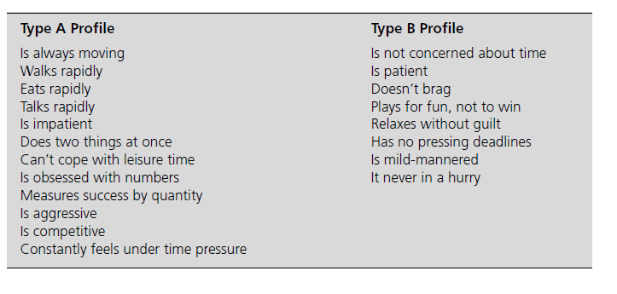
Profiles of Type A and Type B Personalities.

Slide 38
Type B personalities are very laid back, are patient, and take a very relaxed, low-key approach to life and their job.
Type A s may release and better cope with their stress than do Type B s.
how workers handle their own aggression is the key factor in determining whether they will experience the kind of stress that can lead to heart attacks, high blood pressure and other health problems.
Personal Control:
Depends on an individual’s perception of control
job satisfaction, people’s feelings about their ability to control a situation are important in determining their level of stress. Eg: if employees feel that they have little control over the work environment and over their own job, they will experience stress.
lack of control turns stress into physical problems, job control has an impact on stress and strain

Slide 39
Learned Helplessness: people can learn to be helpless, which helps employees just seem to have given up and seem to accept stressors in their work environment, even when a change for the better is possible.
Psychological Hardiness: People able to cope successfully with extreme stressors seem to have a “hardiness” disposition.
hardy executives had a lower rate of stress-related illness and were characterized as having commitment (they became very involved in what they were doing); welcoming challenge (they believed that change rather than stability was normal); and feeling in control (they felt they could influence the events around them).
Employees with positive psychological resources (i.e., efficacy, hope, optimism, resiliency, and overall psychological capital) combat the stressors that they face at work.

Slide 40
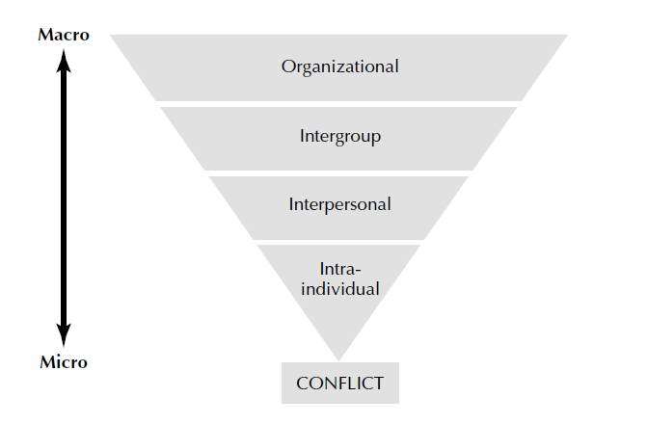
IntraIndividual Conflict
Conflict: a disagreement
in ideas
Fig: level of conflict in OB

Slide 41
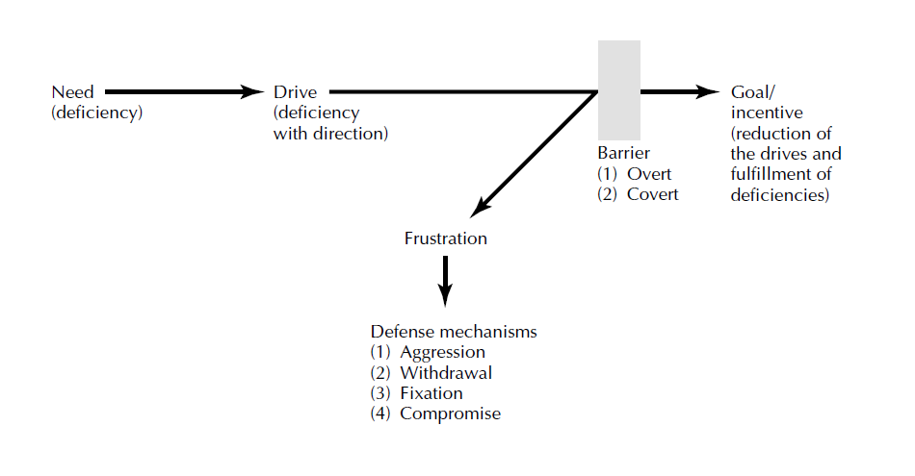
Conflict Due to Frustration
Frustration occurs when a motivated drive is blocked before a person reaches a desired goal.
The barrier may be either overt (outward, or physical) or covert (inward, or mental-sociopsychological).

Slide 42
Conflict Due to Frustration
→incidences of workplace aggression are a reaction to frustration
Level of aggression depends on individual differences (e.g., trait anger, attribution style, negative affectivity, attitudes toward revenge, self-control, and previous exposure to aggressive cultures)
→Implementing a violence-prevention policy and providing training to supervisors and employees in workplace-violence awareness seems to decrease the incidence rate for employee-on employee violence.
In addition to aggression and violence, the withdrawal reaction to frustration may lead to “motivational problem” of employees.
In some cases frustration may actually result in a positive impact on individual performance and organizational goals. An example is the worker or manager who has high needs for competence and achievement and/or who has high self-efficacy in being able to do a job well.

Slide 43
Goal Conflict
Another common source of conflict for an individual is a goal that has both positive and negative features, or two or more competing goals.
Whereas in frustration motives are blocked before the goal is reached, in goal conflict two or more motives block one another.
three separate types of goal conflict:
1. Approach-approach conflict, where the individual is motivated to approach two or more positive but mutually exclusive goals.
2. Approach-avoidance conflict, where the individual is motivated to approach a goal and at the same time is motivated to avoid it. The single goal contains both positive and negative characteristics for the individual.
3. Avoidance-avoidance conflict, where the individual is motivated to avoid two or more negative but mutually exclusive goals.

Slide 44
Role Conflict and Ambiguity
role is defined as a position that has expectations evolving from established norms.
People in society will have many roles to play.
three major types of role conflict:
conflict between the person and the role. There may be conflict between the person’s personality and the expectations of the role. For example, a production worker and member of the union is appointed to head up a new production team.
A second type is intrarole conflict created by contradictory expectations about how a given role should be played. Should the new team leader be autocratic or democratic in dealing with the team members?
interrole conflict results from the differing requirements of two or more roles that must be played at the same time. For example, a successful executive working for a computer company said that she often worked from 7:30 A.M. to 11:30 P.M. Her long hours led to the breakup of a relationship.

Slide 45
Interactive Conflict: →Reflect in interpersonal and intergroup levels.
Interpersonal Conflict:
four major sources of interpersonal conflict are:
1.Personal differences: Everyone has a unique background because of his or her upbringing, cultural and family traditions, and socialization processes. A disagreement about who is factually correct easily turns into a bitter argument over who is morally right.
2. Information deficiency : due to the communication breakdown in the organization. It may be that the two people in conflict are using different information or that one or both have misinformation.

Slide 46
3. Role incompatibility: draws from both intraindividual role conflict and intergroup conflict. For eg: managers have functions and tasks that are highly interdependent. However, the individual roles of thesemanagers may be incompatible.
4. Environmental stress: caused by a stressful environment. In environments characterized by scarce or shrinking resources, downsizing, competitive pressures, or high degrees of uncertainty, conflicts will arise.
Along with these sources, it is useful to analyze the dynamics of individuals interacting with one another.

Slide 47
Intergroup Behavior and Conflict
→Intergroup behavior occurs whenever individuals belonging to one group interact, collectively or individually, with another group or its members in terms of their reference group identification.
Several antecedent conditions identified for explaining intergroup conflict are:
1.Competition for resources.
2.Task interdependence
3.Jurisdictional ambiguity
4.Status struggles
→low intragroup cohesiveness and negative relationships across groups were significantly related to higher perceptions of intergroup conflict.
→ make a cost-benefit analysis of the conflict situation at any level and then set up dispute resolution systems.

Slide 48
The Effects of Stress and IntraIndividual Conflict
→The performance of many tasks is in fact strongly affected by stress.
Performance usually drops off sharply when stress rises to very high levels
Physical Problems Due to Stress and Conflict
Includes 1) immune system problems, where there is a lessened ability to fight off illness and infection;
(2) cardiovascular system problems, such as high blood pressure and heart disease; (3) musculoskeletal system problems, such as tension headaches and back pain; and (4) gastrointestinal system problems, such as diarrhea and constipation.
Psychological Problems Due to Stress and Conflict
→High levels of stress may be accompanied by anger, anxiety, depression, nervousness, irritability, tension, and boredom.
→These types of psychological problems from stress results in poor job performance, lowered self-esteem, inability to concentrate and make decisions, and job dissatisfaction.

Slide 49
Behavioral Problems Due to Stress and Conflict
→Direct behaviors due to high levels of stress include undereating or overeating, sleeplessness, increased smoking and drinking, and drug abuse.
There is relationship between stress and absenteeism and turnover. For example, workers may experience stress and react by getting drunk and staying home from work the next day with a hangover; results in absenteeism or quitting the job later on.
→the behavioral problems are often not attributed to stress by coworkers or supervisors.

Slide 50
Coping strategies for Stress and Conflict
Individual Coping Strategies:self-help remedies, do-it-yourself approaches, weight-loss clinics and diets, health foods, and physical exercise can help.
→techniques that individuals can use to eliminate or more effectively manage inevitable, prolonged stress are:
Exercise. 2. Relaxation 3. Behavioral self-control.
4. Cognitive therapy. 5. Networking.

Slide 51
Organizational Coping Strategies
→designed by management to eliminate or control organizational-level stressors in order to prevent or reduce job stress for individual employees.
→most firms today are trying to reduce stress and conflict through work-family initiatives. These involve both reorganization initiatives (e.g., restructuring of jobs and job duties, telecommuting, part-time work and job sharing, and flexible scheduling) and work and life benefit policies and programs (e.g., on-site child care and/or elder care, paid family and medical leave, release time for personal/family events etc:)
→Employee assistance programs (EAPs) have also become a very valuable organizational response to help employees cope with stress.
guidelines to help downsized organizations combat the problems of survivor syndrome:
Be proactive
2. Acknowledge survivors’ emotions
3. Communicate after the downsizing
4. Clarify new roles.

Slide 52
Negotiation Skills
Traditional Negotiation Approaches:
Distributive bargaining
Positional bargaining
Contemporary Negotiation Skills
Low-risk negotiation techniques
High-risk negotiation techniques
Principled negotiation
Self Learning topic.

Slide 53
THANK YOU!!

